Slide 1

Course Introduction
Partner logo

Slide 2
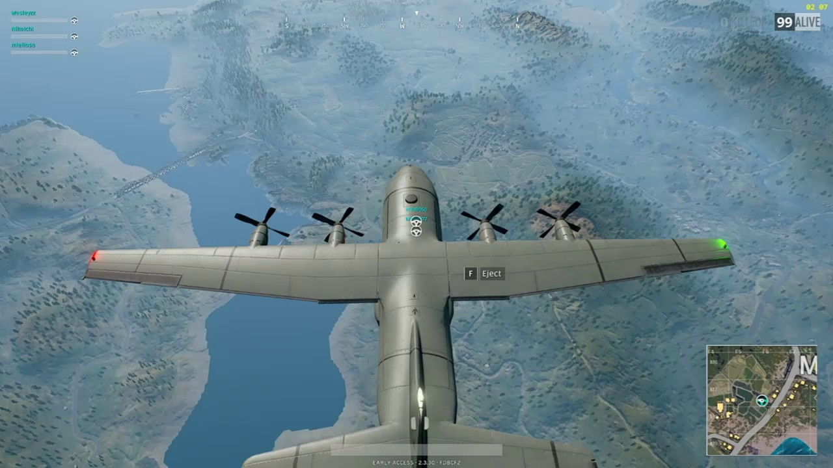
PUBG Flight Drop

Slide 3
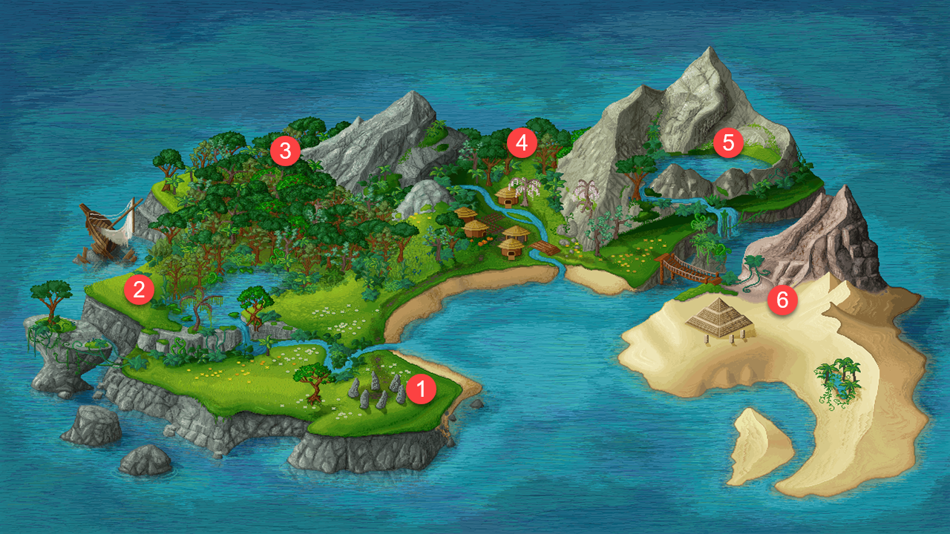
TechKnow School Island
EDA and Visualization
ML Algorithms
PAL and APL
Python Intro and Math Foundation
Intro to ML and Data Science
SAP Leonardo

Slide 4
Technical Evangelists

Slide 5
Thank you.
Partner logo

